Slide 1
Total Joint and Orthopedic Program Overview
Kristen Moeller, MSN, MBA, RN
Nurse Manager/Total Joint Program Coordinator

Slide 2
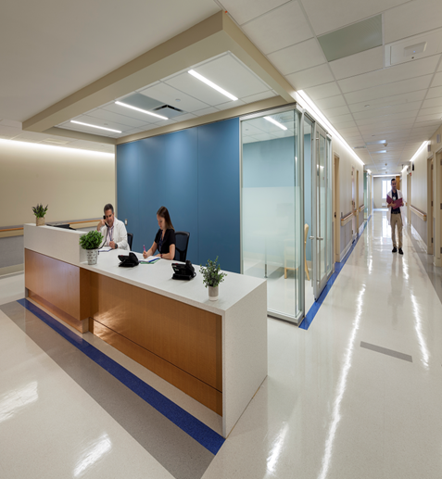
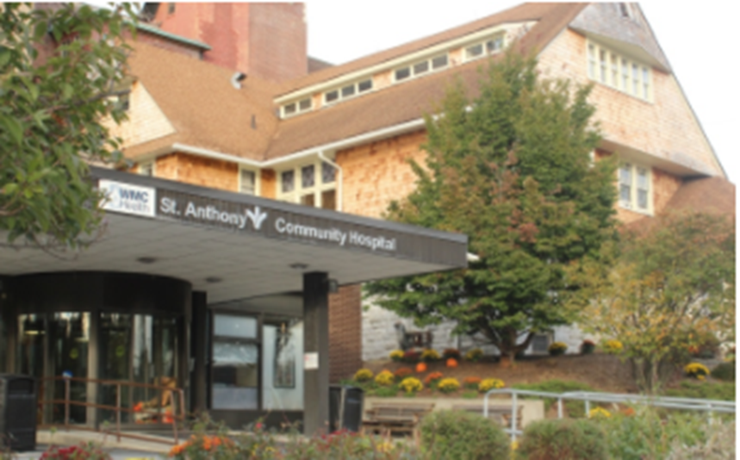

Our Facilities
Total Joint Center (GSH):
St. Anthony Hospital Orthopedic Unit:
Opened August 2019
14 Private Rooms
Physical Therapy/Occupational Therapy gym present on unit
PT gym includes a staircase, shower, and car to ensure patients are ready to perform activities of daily living independently and safely at home
7 Private Rooms

Slide 3

Overview of TJ Replacement Process
Patients arrive at preadmission testing location for the following:
  Meet with Orthopedic Coordinator
  Meet with Hospitalist
  Meet with Anesthesiologist
    Review medical history
    Previous anesthesia experience
    Spinal anesthesia vs. general anesthesia
1:1 interview with nurse to complete assessment and review medical/surgical history
Obtain EKG, Urinalysis, CBC, Chem 7, Coagulation studies, Type and Screen
Finish with x-rays and CT Scan ( a majority of orthopedic surgeons use the MAKO Robot for joint replacements, which requires CT scan of the affected joint)
SACH uses the ROSA Robot for Knee replacements which requires a series of x-rays to create a 3D view of the knee

Slide 4
Pre-Procedure Patient Education
  Initial education initiated in providers office
    Starts at MD office where patients are presented site specific Orthopedic Booklet for surgery
    Additional education offered through the course offered by GSH
  The Orthopedic Coordinator’s initial interaction with each patient occurs at preadmission testing or during the preadmission period. Additional education is provided to the patient and their family
    Goal is 100% compliance to provide a platform of informed and educated consumers of care from preoperative planning to post operative and discharge
  HOOS and KOOS assessment
    Nurses complete a pre-procedure assessment of the patient’s functional status
    Goal is 100% compliance that this assessment is completed.

Slide 5
Day of Surgery Priority Items
Surgical Anesthesia/Pain Management
Post OP Pain Management
Early Ambulation
Interventions
  Antibiotics
  DVT prophylaxis
Frequent Assessments
Safe Discharge

Slide 6
Anesthesia & Pain Management
Surgical Anesthesia
  We are tracking the use of Spinal versus general (spinal is preferred method).
    Documentation by the anesthesiologist should specify why the patient needed general if used.
  Peripheral blocks
    We use peripheral blocks on all patients unless there are exclusions such as spinal stenosis or previous spinal surgery etc.
    Locations of blocks include:
      Hip- Anterior hip
      Knee- Popliteal block, adductor canal
      Shoulder- interscalene block (last anywhere from 8 - 72 hours)
    Blocks take approx. 6-10 hours to wear off, can affect ambulation efforts
    These blocks allow for excellent post-operative pain management in the immediate period after surgery
Post Operative Pain Management
  We use a combination of IV Tylenol, Gabapentin, Celebrex, and Oxycodone XR
  It is important to medicate for pain because it will help the patient participate in PT and with getting and staying out of bed.

Slide 7

Pain Control & Early Ambulation
Patient comfort is our top priority!
Please remember that although controlling pain is our top priority, no surgical procedures are pain free. Our goal is to mitigate post operative pain and provide comfort.
Anesthesiologist will formulate the best and most appropriate medication regimen to control pain and adjust treatments accordingly.
The Anesthesiologist, surgeon, and nursing staff will do everything they can to ensure patient’s pain is manageable.
PRN medications may be administered orally contingent on pain rating scale with overall goal of decreased narcotic consumption and pain optimization prior to home discharge
PCA is rarely used for pain control.

Slide 8
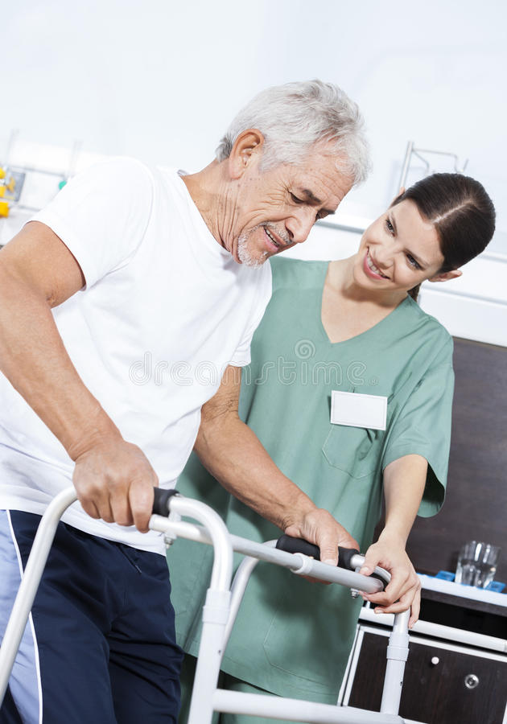
Post-operative Early Ambulation
Patients are ambulated within 4 hours after being stabilized in PACU (after meeting the criteria)
  PACU has a smart phrase that adds the start time for the 4-hour ambulation window. Please include this in your hand-off between units and shifts at the beginning of their stay.
  Late cases may require RNs to ambulate patients. Do not wait for Physical Therapy (PT) to ambulate with patient if PT is not available within 4 hour period.
There are exclusions for ambulating within 4 hours:
  Buckling, hypotension, N/V
  Nurses or PT/ OT need to document any reason why the patient cannot ambulate within that 4-hour window.
Documentation of total distance walked needs to be in the chart
  Getting a patient up to use bathroom counts! Estimate the distance to the toilet or commode and back.

Slide 9
Interventions
Antibiotic Therapy
  Prophylactic antibiotics need to be administered within (1) hour of incision time. Cefazolin 1 or 2 G IV and/or Vancomycin for patients who have had adverse reactions to Cefazolin specifically.
DVT Prophylaxis (GSH)
  Application of sequential compression devices (SCDs) post-op.
  Lovenox initiation beginning 24 hours after the anesthesia end time.
  ASA 81 mg BID x 30 days is started when the patient is deemed appropriate to safely discharge home. Unless they have a hx of hyper coagulopathy, they will return to pre-op medication regimen.
  Use of TED stockings x 2 weeks postoperatively at home.
  If patients go to rehab facility, prophylactic Lovenox dosing is continued upon discharge.

Slide 10
Interventions
DVT Prophylaxis (SACH)
  Application of sequential compression devices (SCDs) intra-op and post-op.
  Aspirin is given according to the surgeon orders which could start day of surgery
  Use of TED stockings x 2 weeks postoperatively at home per surgeon order

Slide 11

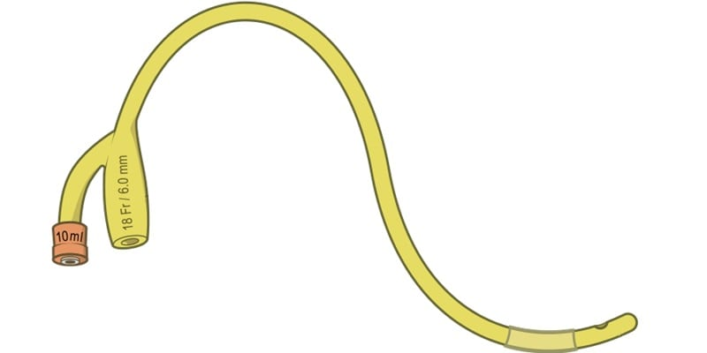
Additional Important Initiatives
AVOID Foley Use! Patients are straight cath’ed at the end of the surgery in the OR. Strong focus on avoidance of foley catheter use.
    Follow appropriate protocols before requesting one be placed.
      Straight cath, bladder scan, and document these attempts in the EMR.
      Purewick and condom catheters are great alternatives to a Foley catheter for incontinence.
      Remember, getting up to use the bathroom is a part of therapy so assisting patients to use the toilet is helping them to heal!

Slide 12
Required Nursing Documentation
Within 1 hour
  Pain Reassessment
Every 4 Hours
  Neurovascular Assessment (8/12/4/8/12/4)
Every Shift
  VTE Documentation
  Incentive Spirometry
  Pain Goal
  Pain Assessment
Every Admission
  At least one care plan
  Education in Discharge Instructions

Slide 13
Expectations of the Clinical Course
Patients will be seen by Physical therapy, Occupational Therapy and/or nursing for early ambulation on the day of surgery as long as medically stable. Goal is that the patient is up within 4 hours of clearance from PACU. PT and RNs are responsible for meeting this metric.
Physical therapy will see patients 1-2 times/day for range of motion and strengthening exercises, along with all functional mobility training to be able to get in and out of bed, ambulate and negotiate stairs.
Occupational therapy will see patients 1-2 times/day to make sure they are comfortable eating, dressing, toileting, and bathing, along with mobility training.
Surgeons and/or Physician Assistant will round daily for assessment and additionally provide a reiteration of education and instructions.
Visit by Case Manager at final discharge planning arrangements.
Orthopedic coordinator rounds daily to provide reinforcement of education through the clinical course, as well as ensuring that the patient is on the planned course of recovery

Slide 14

Safe Discharge Home is Main Objective
Discharge to home is preferred over rehab facility.
    Determined by patients' response to surgery and progress with PT/OT, the interdisciplinary team (IDT), as well as patient’s preference and supportive home environment.
  Things to take into consideration:
    How well are patients performing with PT/OT?
    Pain level post operatively
    Are there multiple comorbidities?
    Is there assistance at home?
    Is everything accessible? Did they make appropriate arrangements ahead of time?
Expected LOS for 2026 is 1.5 days for both Hips and Knees with a focus on same day discharge.
Any patients going to rehab need to meet clinical criteria. Staff must provide supportive documentation.

Slide 15
Post Discharge Care
Patient’s care does not end after being discharged from the hospital !
At home physical therapy sessions may start within 24 hours of discharge, pending insurance authorization. These occur for 2 weeks, between 2-3 times a week.
Follow up visitation with the surgeon within 7-14 days
Direct access to orthopedic coordinator, who provides continued communication across the multifaceted care team

Slide 16
Thank You
Please contact Orthopedic Coordinator for any questions related to joint patients.

